Slide 1

Jarrell
Independent School District
4Q21
Demographic Report

Slide 2
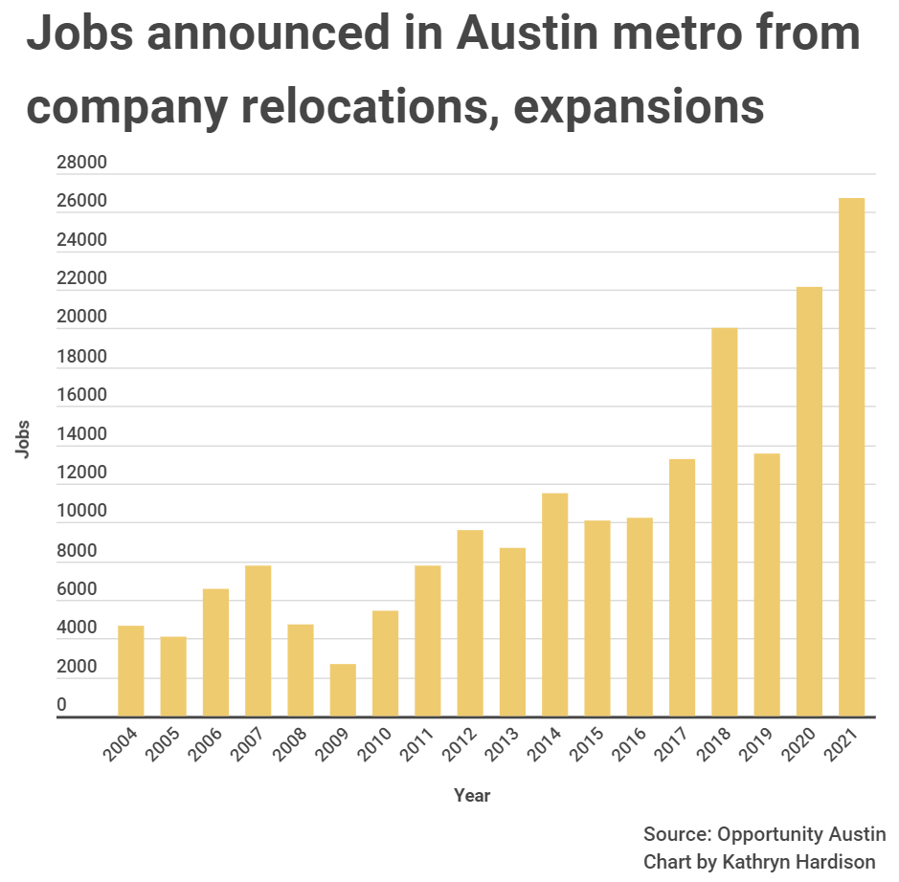
Local Economic Update- Austin MSA
Source: Dallas Business Journal & Dallas Morning News
Notes:
Notes: Walmart Fulfillment Center- spans 2 buildings on 292 acres 3.5 miles east of Lancaster; Fulfillment center will span 1.2 million sq. ft. and cost $420 million, 1000 jobs will be created within 3 years of opening; Cold Storage Warehouse spanning 700,000 sq. ft. will be the 2nd building located at the southwest corner of E Pleasant Run & Cornell Rd, total cost $380 million creating 300 jobs within the first 3 years of opening; Deal between Walmart and the city of Lancaster includes property tax abatements of up to 65% for 15 years as long as property value does not fall, a 50% rebate of city’s 1% sales tax is also included on merchandise shipped from facility for 5 years; estimated to bring in more than $34 million in annual revenue over next 15 years
Uber HQ- HQ will span 25-stories at 2550 Pacific Ave, Dallas; Avg salary of workers $100K; will become largest hub outside of San Francisco

Slide 3
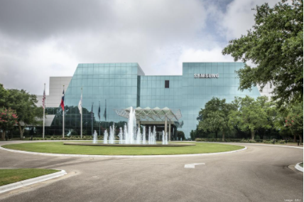
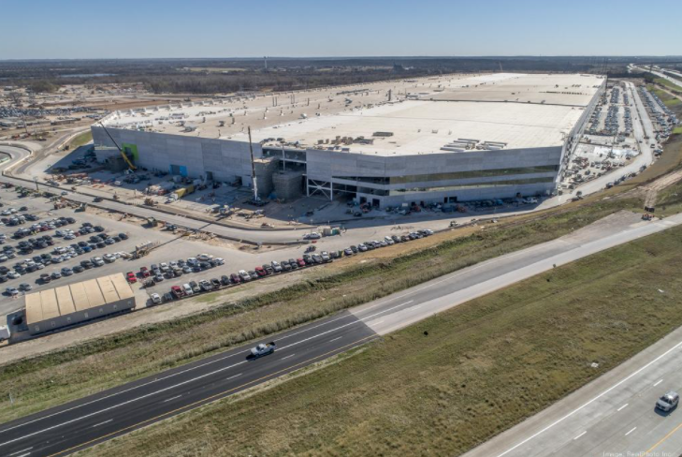
Local Economic Update- Austin MSA
Samsung
Samsung Electronics Co. Ltd. has officially pledged to invest at least $17 billion into a chipmaking plant in Taylor. The company promises to create at least 2,000 direct jobs, at least 6,500 construction jobs and a 6-million-square-foot factory on roughly 1,200 acres between Taylor and Hutto. The factory will produce the South Korea-based company’s most advanced computer chips yet.
Tesla
Tesla Inc. also relocated its headquarters to the Austin area, where its $1.1 billion electric vehicle manufacturing facility has developed at breakneck speed. Musk's hiring goals also continue to swell from the originally promised 5,000 positions. He recently said that the Austin-area factory will grow to a $10 billion-plus investment "over time" that will create at least 20,000 direct jobs and 100,000 indirect jobs.
Notes:
Notes: Facebook Expansion- will have more than 2.6 million sq. ft. upon completion, an overall investment of $1.5 billion; utilizes “cold storage” to house older digital photos & posts; supported by renewable energy (wind & solar)

Slide 4



Local Economic Update- Austin MSA
Shop LC
Shop LC announced the relocation of its national headquarters to Cedar Park. The television network and online retailer plans to create more than 1,000 new jobs and $50 million in capital investment with the move.
Green Dot
Green Dot is a fintech company that was formerly based in California. The company recently announced that they are moving their headquarters to Austin.
GovOS
Digital document management company, GovOS Inc, moved their headquarters to Austin. The company plans to build a team of 100 new employees by the end of the year.
Notes:
Notes: Facebook Expansion- will have more than 2.6 million sq. ft. upon completion, an overall investment of $1.5 billion; utilizes “cold storage” to house older digital photos & posts; supported by renewable energy (wind & solar)

Slide 5
Jarrell ISD Housing Market Analysis
Home Sales by Transaction Type, 2010 – 2021
In 2021, there were approx. 1,500 total home sales in Jarrell ISD
The number of new home sales have increased dramatically over the last 10 years
Sources: Metrostudy & Tarrant County Deed Transactions

Slide 6
Jarrell ISD Housing Market Analysis
Average New vs. Existing Home Sale Price, 2010 – 2021
 | Avg New Home Price | Avg Existing Home Price
2010 | $176,203 | $148,206
2011 | $201,547 | $170,897
2012 | $162,264 | $178,128
2013 | $166,792 | $178,718
2014 | $181,398 | $197,676
2015 | $192,883 | $192,272
2016 | $199,152 | $212,268
2017 | $208,578 | $215,709
2018 | $251,055 | $239,558
2019 | $234,325 | $246,839
2020 | $235,052 | $249,976
2021 | $257,634 | $304,319
Since 2010, the average new home price in Jarrell ISD has increased by $81,431, or 46.2%
The average existing home price within the district has increased by 105.3%, or roughly $156,113 since 2010

Slide 7
Austin New Home Ranking Report
ISD Ranked by Annual Closings – 4Q21
Rank | District Name | Annual Starts | Annual Closings | Inventory | VDL | Future
1 | Leander ISD | 3,054 | 2,500 | 1,973 | 2,753 | 7,650
2 | Georgetown ISD | 2,937 | 2,383 | 1,788 | 4,133 | 17,164
3 | Hays CISD | 3,296 | 2,153 | 2,275 | 2,929 | 41,319
4 | Liberty Hill ISD | 2,575 | 2,058 | 1,347 | 1,829 | 10,595
5 | Pflugerville ISD | 1,737 | 1,518 | 1,211 | 811 | 9,654
6 | Austin ISD | 1,625 | 1,371 | 1,654 | 1,522 | 10,427
7 | Del Valle ISD | 1,213 | 1,351 | 622 | 1,092 | 23,204
8 | Hutto ISD | 1,908 | 1,276 | 1,138 | 1,281 | 8,484
9 | Manor ISD | 1,296 | 1,139 | 807 | 1,274 | 14,878
10 | Jarrell ISD* | 1,336 | 1,029 | 664 | 1,008 | 12,383
11 | Dripping Springs ISD | 1,130 | 886 | 760 | 969 | 6,984
12 | Lake Travis ISD | 968 | 646 | 787 | 917 | 4,106
13 | Bastrop ISD | 931 | 625 | 641 | 2,672 | 16,294
14 | Round Rock ISD | 778 | 558 | 666 | 910 | 5,533
15 | San Marcos CISD | 878 | 430 | 717 | 840 | 6,025
16 | Elgin ISD | 377 | 413 | 98 | 381 | 8,778
17 | Taylor ISD | 228 | 205 | 121 | 333 | 877
18 | Lago Vista ISD | 260 | 179 | 186 | 506 | 4,025
19 | Lockhart ISD | 52 | 60 | 26 | 80 | 16,345
20 | Wimberley ISD | 24 | 10 | 19 | 59 | 0
* Based on additional Zonda Education housing research
**Includes Age-Restricted subdivisions

Slide 8
District New Home Starts and Closings
Starts | 2015 | 2016 | 2017 | 2018 | 2019 | 2020 | 2021 |  | Closings | 2015 | 2016 | 2017 | 2018 | 2019 | 2020 | 2021
1Q | 49 | 36 | 44 | 51 | 55 | 155 | 306 |  | 1Q | 52 | 45 | 85 | 72 | 85 | 129 | 244
2Q | 66 | 62 | 111 | 121 | 129 | 135 | 339 |  | 2Q | 65 | 45 | 53 | 32 | 97 | 195 | 263
3Q | 37 | 82 | 103 | 112 | 248 | 241 | 285 |  | 3Q | 68 | 62 | 109 | 99 | 107 | 166 | 342
4Q | 45 | 86 | 73 | 81 | 160 | 251 | 406 |  | 4Q | 38 | 45 | 98 | 88 | 180 | 223 | 180
Total | 197 | 266 | 331 | 365 | 592 | 782 | 1,336 |  | Total | 223 | 197 | 345 | 291 | 469 | 713 | 1,029

Slide 9
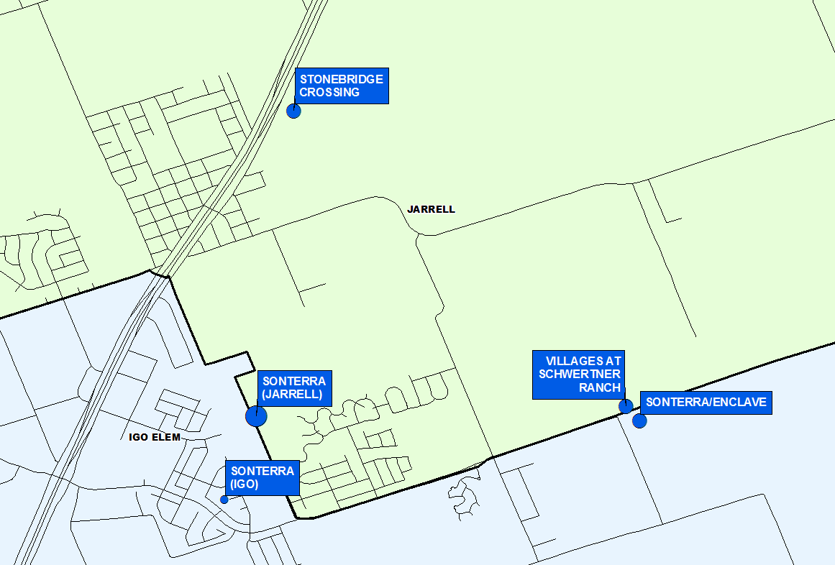
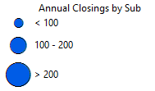
Annual Closing Distribution
Top 5 Subdivisions - 4Q21 (Ranked by Annual Closings)
Rank | Subdivision | Annual Closings | Quarter Closings | VDL | Future
1 | SONTERRA (JARRELL) | 474 | 51 | 0 | 1,179
2 | STONEBRIDGE CROSSING | 178 | 33 | 204 | 10
3 | SONTERRA ENCLAVE | 137 | 16 | 1 | 0
4 | VILLAGES AT SCHWERTNER RANCH | 134 | 46 | 16 | 710
5 | SONTERRA (IGO) | 32 | 0 | 16 | 1,181
 | Grand Totals | 955 | 146 | 237 | 3,080

Slide 10
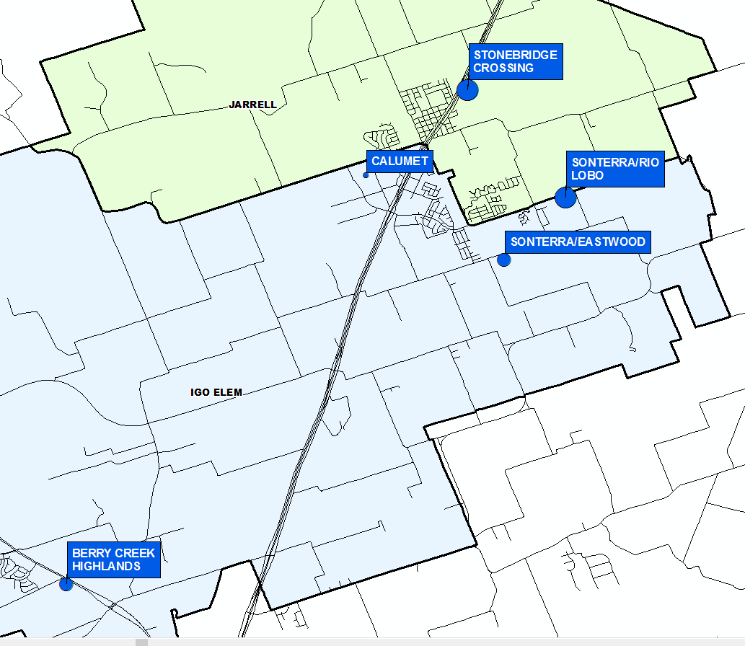
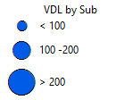
VDL Distribution
Top 5 Subdivisions - 4Q21 (Ranked by remaining VDL)
Rank | Subdivision | Annual Closings | Quarter Closings | VDL | Future
1 | SONTERRA RIO LOBO | 0 | 0 | 226 | 0
2 | STONEBRIDGE CROSSING | 178 | 33 | 204 | 10
3 | SONTERRA EASTWOOD | 0 | 0 | 173 | 815
4 | BERRY CREEK HIGHLANDS | 0 | 0 | 111 | 1,058
5 | CALUMET | 21 | 7 | 66 | 99
 | Grand Totals | 199 | 40 | 780 | 1,982

Slide 11
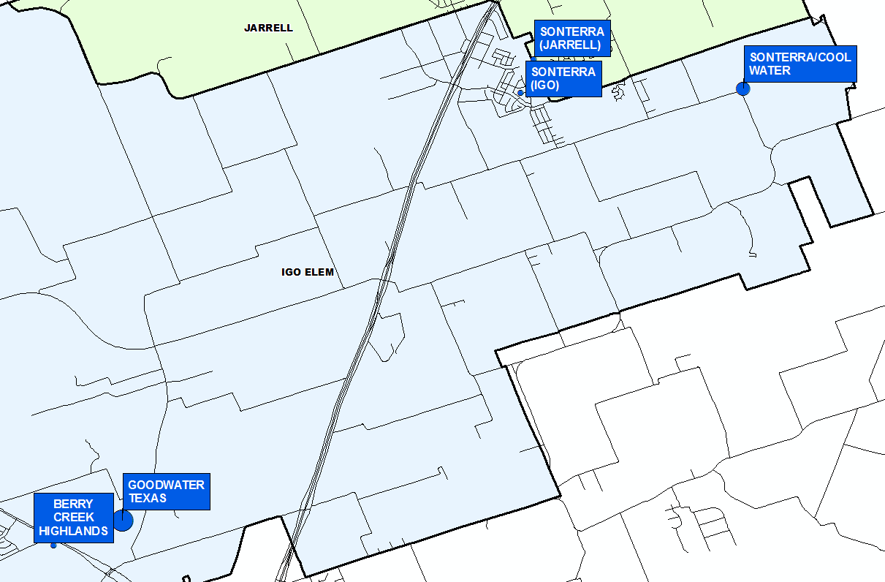
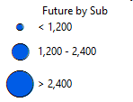
Futures Distribution
Top 5 Subdivisions - 4Q21 (Ranked by Future Inventory)
Rank | Subdivision | Annual Closings | Quarter Closings | VDL | Future
1 | GOODWATER TEXAS | 0 | 0 | 0 | 2,500
2 | SONTERRA COOL WATER | 17 | 17 | 23 | 1,367
3 | SONTERRA (IGO) | 32 | 0 | 16 | 1,181
4 | SONTERRA (JARRELL) | 474 | 51 | 0 | 1,179
5 | BERRY CREEK HIGHLANDS | 0 | 0 | 111 | 1,058
 | Grand Total | 523 | 68 | 150 | 7,285

Slide 12
District Housing Overview by Elementary Zone
Elementary Zone | Annual Starts | Quarter Starts | Annual Closings | Quarter Closings | U/C | Inventory | VDL | Future
IGO | 575 | 271 | 224 | 47 | 414 | 444 | 752 | 9,407
JARRELL | 761 | 135 | 805 | 133 | 185 | 220 | 256 | 2,976
Grand Total | 1,336 | 406 | 1,029 | 180 | 599 | 664 | 1,008 | 12,383

Slide 13
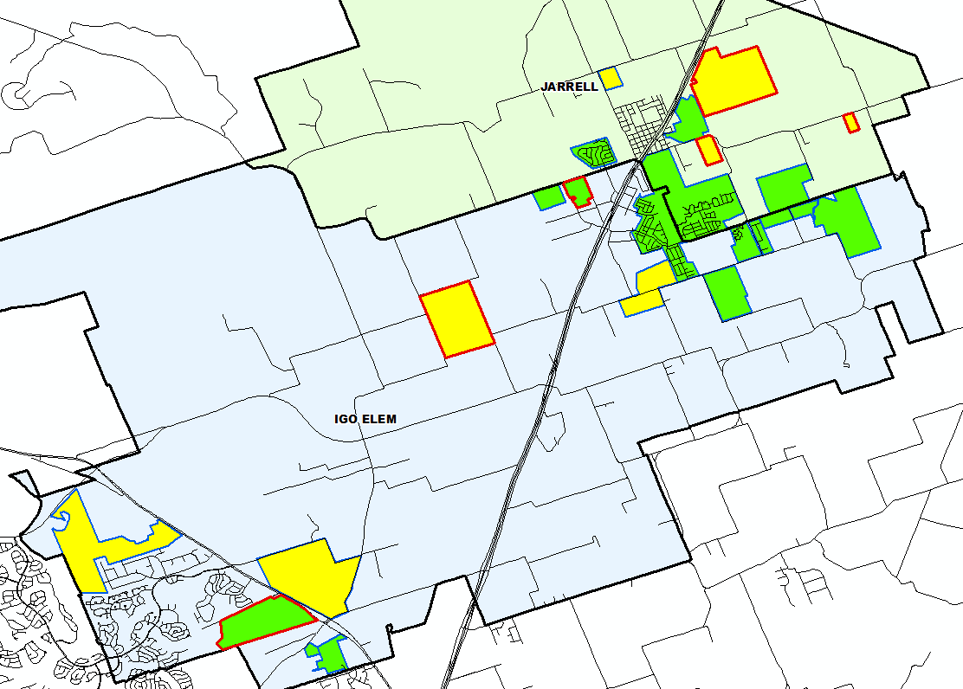
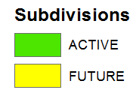

District Housing Overview
The district has 15 actively building subdivisions
Within Jarrell ISD there are 8 future subdivisions
Of these, groundwork is underway on more than 1,000 lots within 6 subdivisions

Slide 14
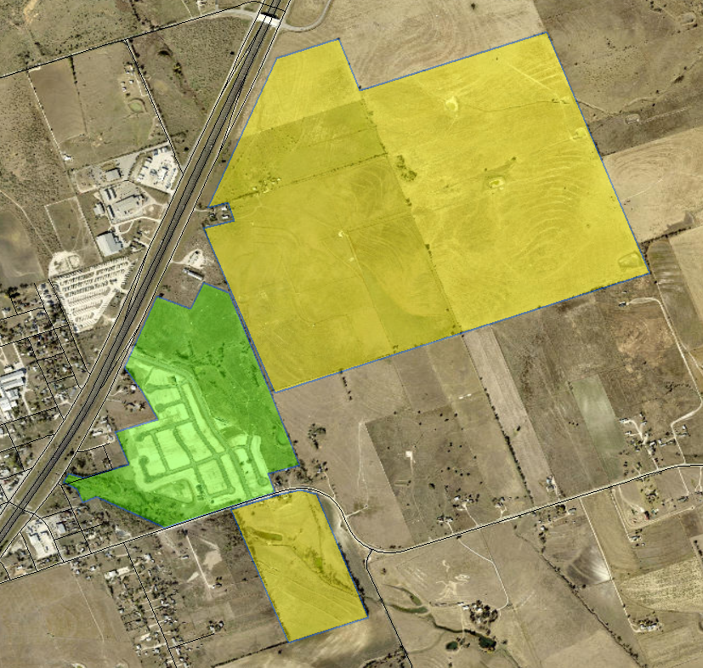
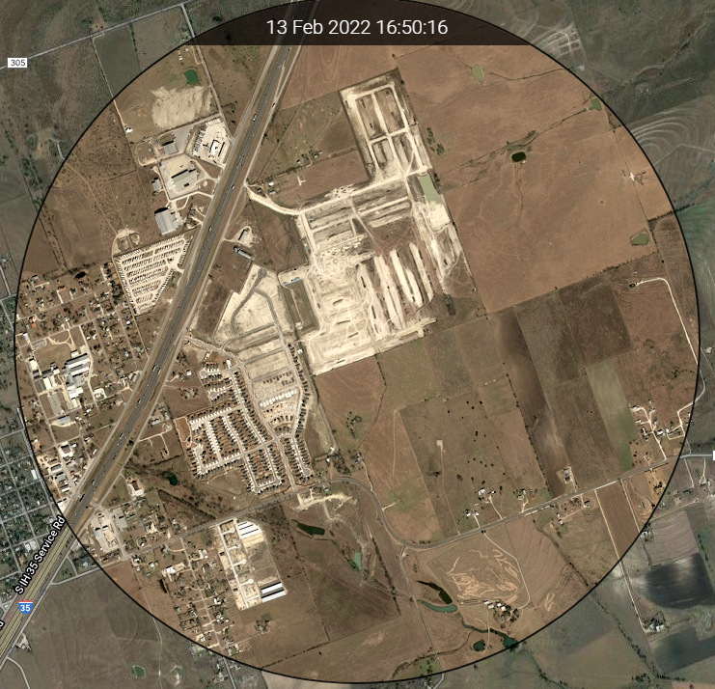
Housing Activity
Stonebridge Crossing
449 total lots
10 future lots
178 occupied homes
204 VDL and 38 homes under construction
18 finished vacant homes
Started 228 homes and closed 178 homes in 2021
Average PP: $235K-$405K
Jarrell Elementary Zone
Eastern Wells
712 total future lots
Groundwork underway on approx. 400 lots (Phases 1 and 2)
Jarrell Elementary Zone
The Stone Crown
125 total future lots
Groundwork underway
Jarrell Elementary Zone

Slide 15
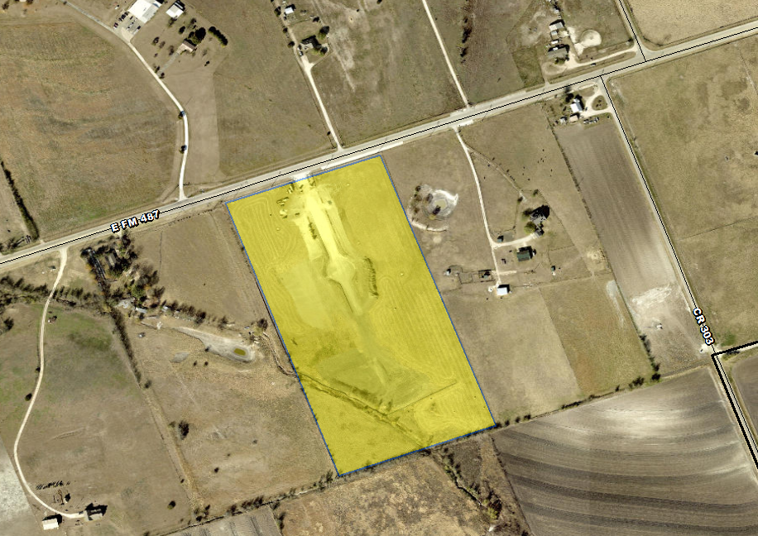
Housing Activity
Enclave at Jarrell
16 total future lots
Groundwork underway on all lots

Slide 16
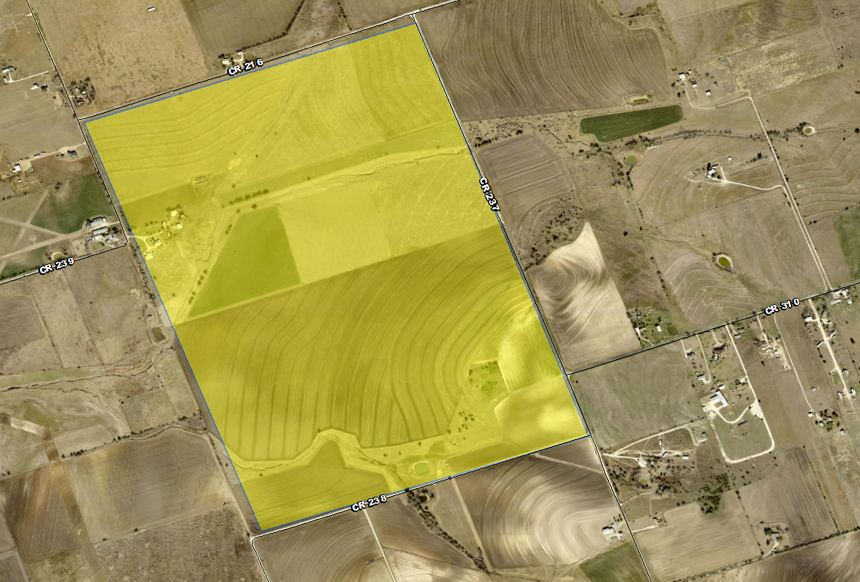
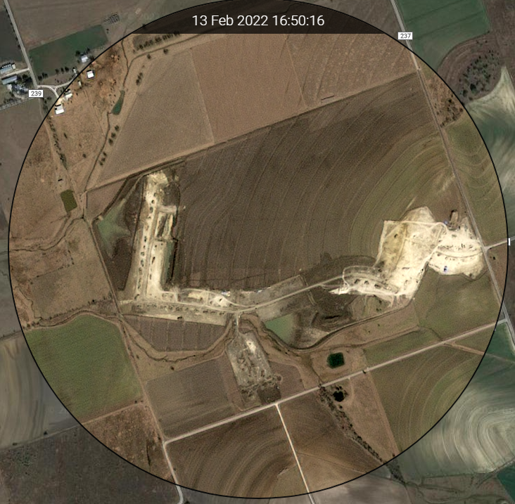
Housing Activity
Rancho del Cielo
941 total future lots
Groundwork underway on Phase 1 (215 lots)
Igo Elementary Zone

Slide 17
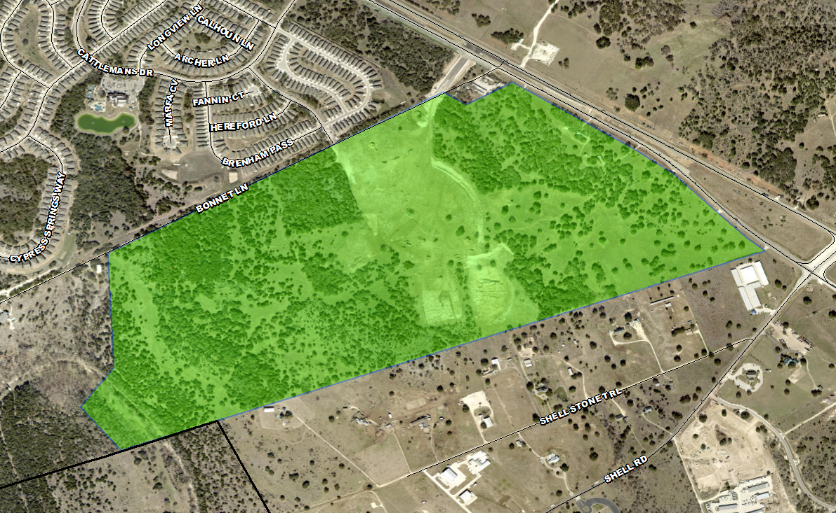
Housing Activity
Berry Creek Highlands
1,169 total lots
1,058 future lots
111 VDL
Masterplan includes single-family and multi-family as well as commercial areas and public facilities
Igo Elementary Zone

Slide 18
Ten Year Forecast by Grade Level
Year (Oct.) | EE | PK | K | 1st | 2nd | 3rd | 4th | 5th | 6th | 7th | 8th | 9th | 10th | 11th | 12th | Total | Total Growth | % Growth
2017/18 | 10 | 80 | 133 | 146 | 133 | 127 | 131 | 120 | 119 | 135 | 108 | 124 | 124 | 113 | 100 | 1,703
2018/19 | 13 | 90 | 142 | 153 | 154 | 138 | 144 | 146 | 141 | 129 | 142 | 136 | 126 | 122 | 121 | 1,897 | 194 | 11.4%
2019/20 | 5 | 108 | 174 | 164 | 171 | 161 | 168 | 159 | 159 | 169 | 143 | 172 | 125 | 120 | 104 | 2,102 | 205 | 10.8%
2020/21 | 4 | 87 | 182 | 198 | 181 | 171 | 170 | 184 | 167 | 170 | 176 | 183 | 177 | 137 | 118 | 2,305 | 203 | 9.7%
2021/22 | 9 | 143 | 223 | 241 | 244 | 224 | 220 | 212 | 210 | 204 | 192 | 218 | 191 | 207 | 140 | 2,878 | 573 | 24.9%
2022/23 | 21 | 200 | 276 | 275 | 291 | 301 | 272 | 272 | 263 | 265 | 249 | 257 | 229 | 220 | 211 | 3,602 | 724 | 25.2%
2023/24 | 23 | 235 | 335 | 337 | 324 | 349 | 361 | 328 | 332 | 321 | 318 | 324 | 270 | 245 | 220 | 4,322 | 720 | 20.0%
2024/25 | 23 | 265 | 380 | 394 | 381 | 367 | 394 | 419 | 397 | 405 | 385 | 411 | 332 | 267 | 240 | 5,060 | 738 | 17.1%
2025/26 | 23 | 280 | 438 | 444 | 460 | 440 | 425 | 457 | 457 | 453 | 435 | 505 | 421 | 329 | 262 | 5,829 | 769 | 15.2%
2026/27 | 23 | 310 | 496 | 517 | 502 | 520 | 505 | 494 | 498 | 503 | 492 | 566 | 518 | 417 | 322 | 6,683 | 854 | 14.7%
2027/28 | 23 | 350 | 553 | 580 | 580 | 560 | 588 | 571 | 531 | 543 | 545 | 590 | 555 | 513 | 409 | 7,491 | 808 | 12.1%
2028/29 | 23 | 370 | 608 | 641 | 634 | 629 | 616 | 647 | 614 | 579 | 587 | 693 | 608 | 549 | 503 | 8,301 | 810 | 10.8%
2029/30 | 23 | 400 | 653 | 700 | 688 | 689 | 692 | 678 | 696 | 669 | 627 | 738 | 701 | 602 | 538 | 9,094 | 793 | 9.6%
2030/31 | 23 | 400 | 702 | 736 | 752 | 747 | 758 | 762 | 729 | 759 | 724 | 779 | 743 | 694 | 590 | 9,898 | 804 | 8.8%
2031/32 | 23 | 400 | 739 | 791 | 776 | 817 | 822 | 834 | 819 | 795 | 822 | 910 | 792 | 736 | 680 | 10,756 | 858 | 8.7%
Yellow box = largest grade per year
Green box = second largest grade per year

Slide 19
Ten Year Forecast by Campus
 |  |  | Fall | ENROLLMENT PROJECTIONS
Campus | Capacity | 2020/21 | 2021/22 | 2022/23 | 2023/24 | 2024/25 | 2025/26 | 2026/27 | 2027/28 | 2028/29 | 2029/30 | 2030/31 | 2031/32
Igo Elementary | 800 | 720 | 849 | 1,033 | 1,251 | 1,476 | 1,721 | 2,012 | 2,333 | 2,597 | 2,854 | 3,101 | 3,333
Jarrell Elementary | 608 | 457 | 667 | 875 | 1,041 | 1,147 | 1,246 | 1,355 | 1,472 | 1,571 | 1,669 | 1,779 | 1,869
ELEMENTARY SCHOOL TOTAL | 1,408 | 1,177 | 1,516 | 1,908 | 2,292 | 2,623 | 2,967 | 3,367 | 3,805 | 4,168 | 4,523 | 4,880 | 5,202
Elementary Absolute Change |  | 67 | 339 | 392 | 384 | 331 | 344 | 400 | 438 | 363 | 355 | 357 | 322
Elementary Percent Change |  | 6.04% | 28.80% | 25.86% | 20.13% | 14.44% | 13.11% | 13.48% | 13.01% | 9.54% | 8.52% | 7.89% | 6.60%
Jarrell Middle School | 764/1,004 | 513 | 606 | 777 | 971 | 1,187 | 1,345 | 1,493 | 1,619 | 1,780 | 1,992 | 2,212 | 2,436
MIDDLE SCHOOL TOTAL |  | 513 | 606 | 777 | 971 | 1,187 | 1,345 | 1,493 | 1,619 | 1,780 | 1,992 | 2,212 | 2,436
Middle School Absolute Change |  | 42 | 93 | 171 | 194 | 216 | 158 | 148 | 126 | 161 | 212 | 220 | 224
Middle School Percent Change |  | 8.92% | 18.13% | 28.22% | 24.97% | 22.25% | 13.31% | 11.00% | 8.44% | 9.94% | 11.91% | 11.04% | 10.13%
Jarrell High School | 995/1,258 | 615 | 756 | 917 | 1,059 | 1,250 | 1,517 | 1,823 | 2,067 | 2,353 | 2,579 | 2,806 | 3,118
HIGH SCHOOL TOTAL |  | 615 | 756 | 917 | 1,059 | 1,250 | 1,517 | 1,823 | 2,067 | 2,353 | 2,579 | 2,806 | 3,118
High School Absolute Change |  | 94 | 141 | 161 | 142 | 191 | 267 | 306 | 244 | 286 | 226 | 227 | 312
High School Percent Change |  | 18.04% | 22.93% | 21.30% | 15.49% | 18.04% | 21.36% | 20.17% | 13.38% | 13.84% | 9.60% | 8.80% | 11.12%
DISTRICT TOTALS |  | 2,305 | 2,878 | 3,602 | 4,322 | 5,060 | 5,829 | 6,683 | 7,491 | 8,301 | 9,094 | 9,898 | 10,756
District Absolute Change |  | 203 | 573 | 724 | 720 | 738 | 769 | 854 | 808 | 810 | 793 | 804 | 858
District Percent Change |  | 9.66% | 24.86% | 25.16% | 19.99% | 17.08% | 15.20% | 14.65% | 12.09% | 10.81% | 9.55% | 8.84% | 8.67%
Yellow box = exceeds capacity
Green box = within 90% of capacity

Slide 20
Key Takeaways
In 2021, there were approx. 1,500 total home sales in Jarrell ISD
The number of new home sales have increased dramatically over the last 10 years
The district has 15 actively building subdivisions with 600 homes under construction
Within Jarrell ISD there are 8 future subdivisions and more than 12,000 future lots
Of these, groundwork is underway on more than 1,000 lots within 6 subdivisions
Jarrell ISD can expect to enroll more than 6,600 students by 2026/27 and more than 10,700 by 2031/32

